Slide 1


Slide 2
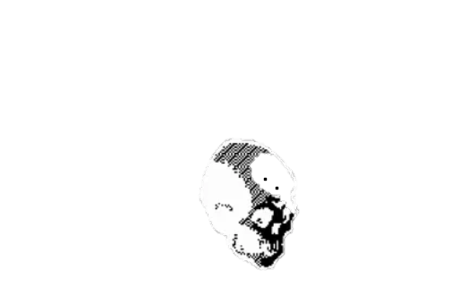
DedSec
Team members:
Sriram deep - 2620030605
Geethika - 2620030370
Charan-2620030617
Haasini-2620030546
Tejaswi - 2620030364

Slide 3
Design and Simulation of a
Digital Access Card
Verification System
Using XOR/XNOR Logic for Combinational Authentication

Slide 4



Abstract
The Digital Access Card Verification System
Using XOR/XNOR Logic is a digital security system
designed to authenticate an access card by comparing
its digital data with authorized data. The system uses
XOR and XNOR gates to identify matching and different bits during verification.
Its working is represented using truth tables and block diagrams to demonstrate the authentication process. The system can be designed and simulated using Logisim,
with basic system requirements of 8 GB RAM and 1 TB
storage. The project demonstrates how digital logic gates
can be applied to digital access control and authentication, providing a simple and reliable method for verifying
authorized access.

Slide 5





Softwares & System Requirements
System Requirements
Softwares
Storage Capacity: 1 TB required for maintaining extensive software binaries, simulation logs, and archived project design files.
Logisim: The primary educational tool utilized for visually designing and simulating digital logic circuits with an intuitive graphical interface.
Memory (RAM): 8 GB minimum requirement to ensure smooth and uninterrupted simulation of complex digital logic arrays.
Ripes: Used alongside Logisim as a visual computer architecture simulator and assembly code execution environment.

Slide 6


Hardware components & Applications
Applications
Hardware
4 switches for card-code input
XNOR gates
AND gate
LED
Resistors
Breadboard
Connecting wires
5V power supply
Logic ICs
Digital door locks
Electronic access systems
Card readers
Digital identification systems
Security-control circuits

Slide 7








Core Concepts
Authentication
Digital Access Card
Working
Digital logic plays a critical role in modern security. Electronic authentication systems require a robust method to determine if a user's input strictly matches an authorized value.
The access card represents a unique binary identification code. The verification circuit reads this code to compare it securely against the system's predefined authorized key.
The system accepts a 4-bit card code, processing it through parallel XNOR gates for bit-by-bit equality checking. An AND gate then combines these results to grant or deny access.

Slide 8






XNOR / XOR Gates
XOR Gate
XNOR Gate
A | B | Y
0 | 0 | 0
0 | 1 | 1
1 | 0 | 1
1 | 1 | 0
A | B | Y
0 | 0 | 1
0 | 1 | 0
1 | 0 | 0
1 | 1 | 1
(4-bit A3-A0)
(Bit-by-bit Compare)
(Final Verification)
(Granted / Denied)

Slide 9

Conclusion
The Digital Access Card Verification System successfully demonstrates how fundamental logic gates tackle real-world authentication.
By utilizing XNOR gates for exact bit-matching and an AND gate for final verification, the circuit provides a robust, foundational understanding of combinational logic design and digital security mechanisms.

Slide 10
Access granted. Security guaranteed.

Slide 11

Thank You

